Slide 1
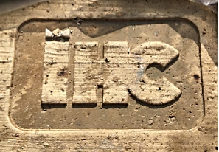
ROYAL IHC
IHC Medusa
1st April 2019
Han van Voorst

Slide 2
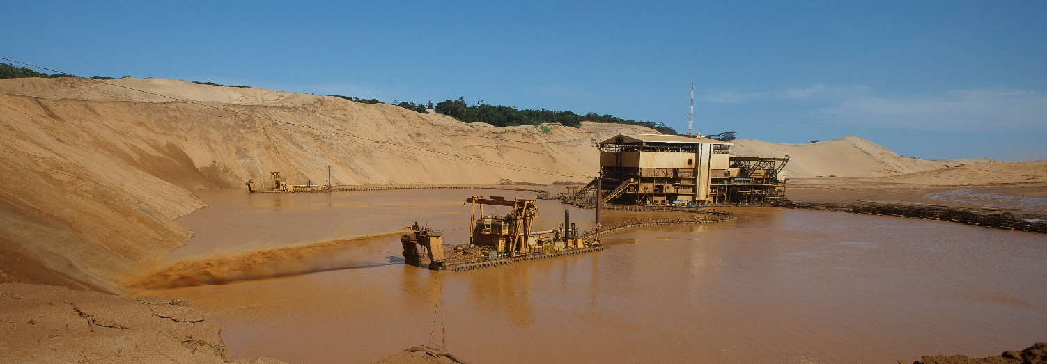
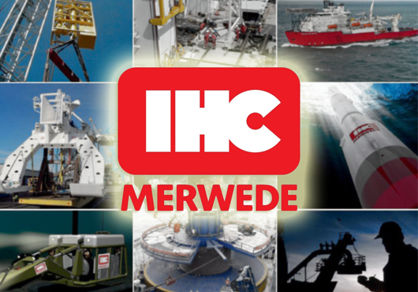
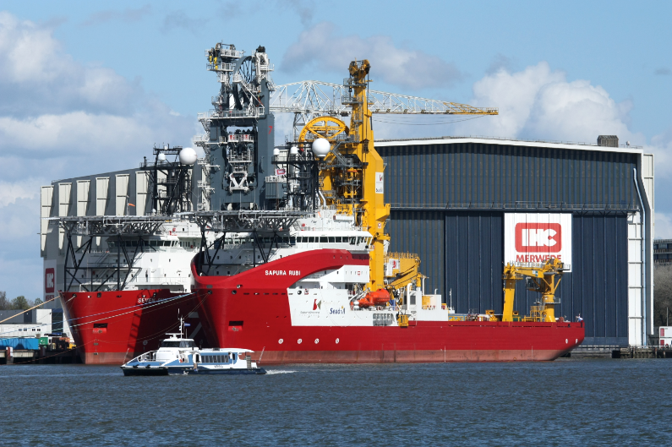
ROYAL IHC
      solutions
      Supply of vessels & equipment
      Consultancy (dredging & mining)
Markets
Dredging
Offshore
Mining
Offshore Wind

Slide 3
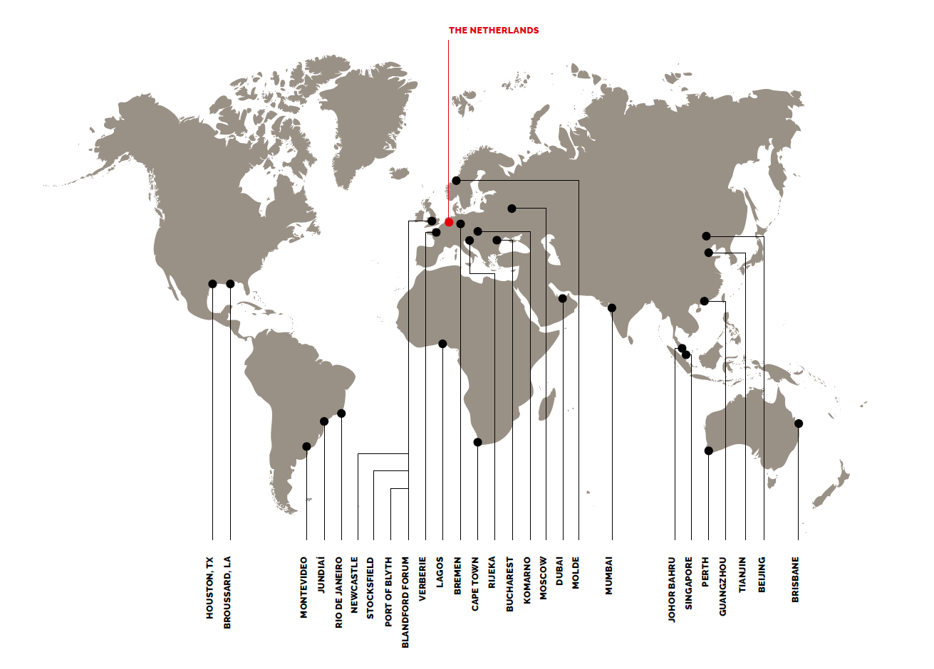
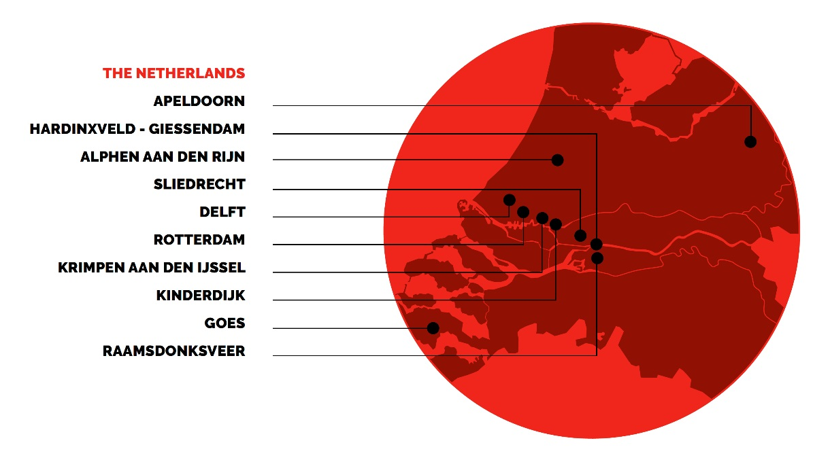
ABOUT IHC > WORLD WIDE

Slide 4
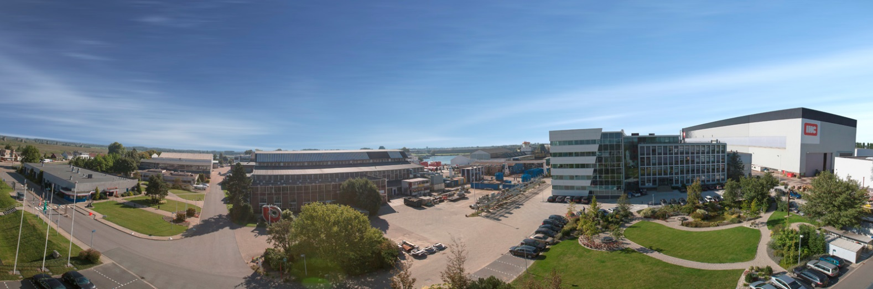
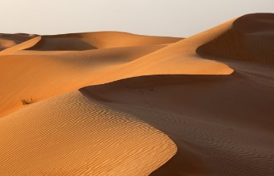
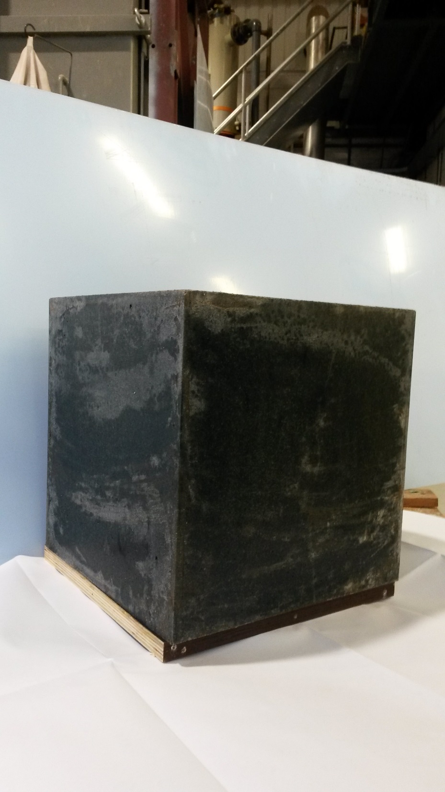
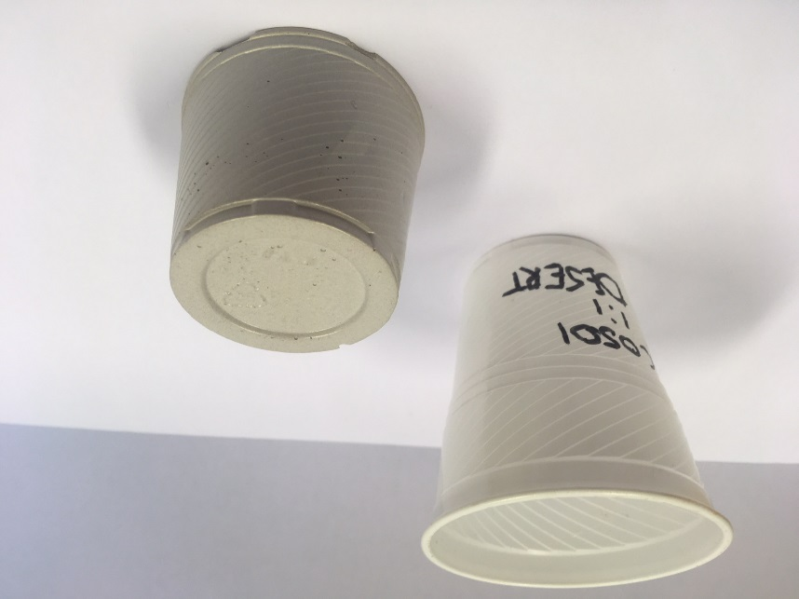
IHC Medusa B.V. > About us
Start-up of Royal IHC, based in Kinderdijk (the Netherlands)
Expertise: designing and supplying binder systems for solidification, stabilization and reuse of waste dredged and mined materials
Vision: To bring a more sustainable binder to markets we are familiar with, making the best use out of waste streams as possible
Notes:
IHC Medusa’s main activity is the development, sale and distribution of its revolutionary soil stabilization system. This allows for the reuse of waste soil in solid, concrete-like, products, as well as reducing the operational logistics at a construction site. In the near future, IHC Medusa will launch its product line.

Slide 5
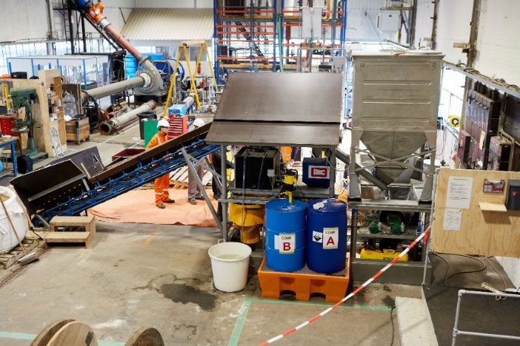
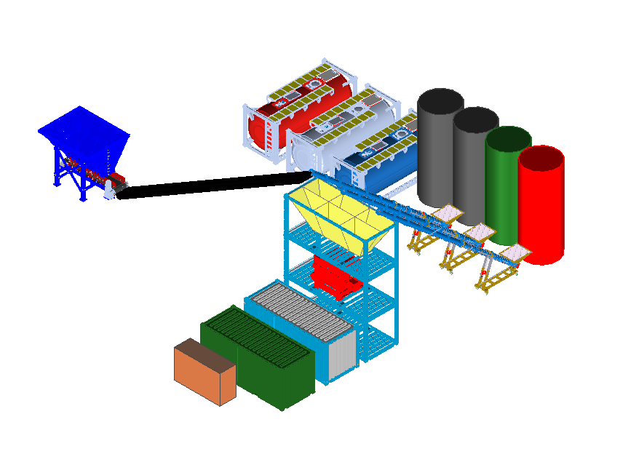
Current focus> development
Two focus areas products
Concrete alternatives (MPa)
Stabilized soil (kPa)
Focus markets
Offshore infrastructure
Public infrastructure
Mining
Technology focus
Continuing upscaling > 50 t/h mobile plant
Residue clay & waste activation
1 ton/h test field prototype
Schematic 50 ton/h installation
Notes:
Offshore: platforms, foundations, oil and gas wells, pipeline/cable protection
Onshore: refineries, process chemical, power generation, mills and manufacturing plants
(concrete) Roads, pavements
Water works: Dams, bridges, (coastal) protection
Ground works: Tunnels, sewer systems, water supply systems
[---]
Liggende containers: liq
-Water
-Liq Act I
-Liq Act II
Drie-poederrecept (more of some than other)
Blauw = aggregaat
Geel = buffer + weighing / dosering
Groen = tools
Licht blauw = control room
Bruin = (diesel) aggregaat > stroomvoorziening
Rood = twin shaft mixer
onder mixer = uit-pomp

Slide 6
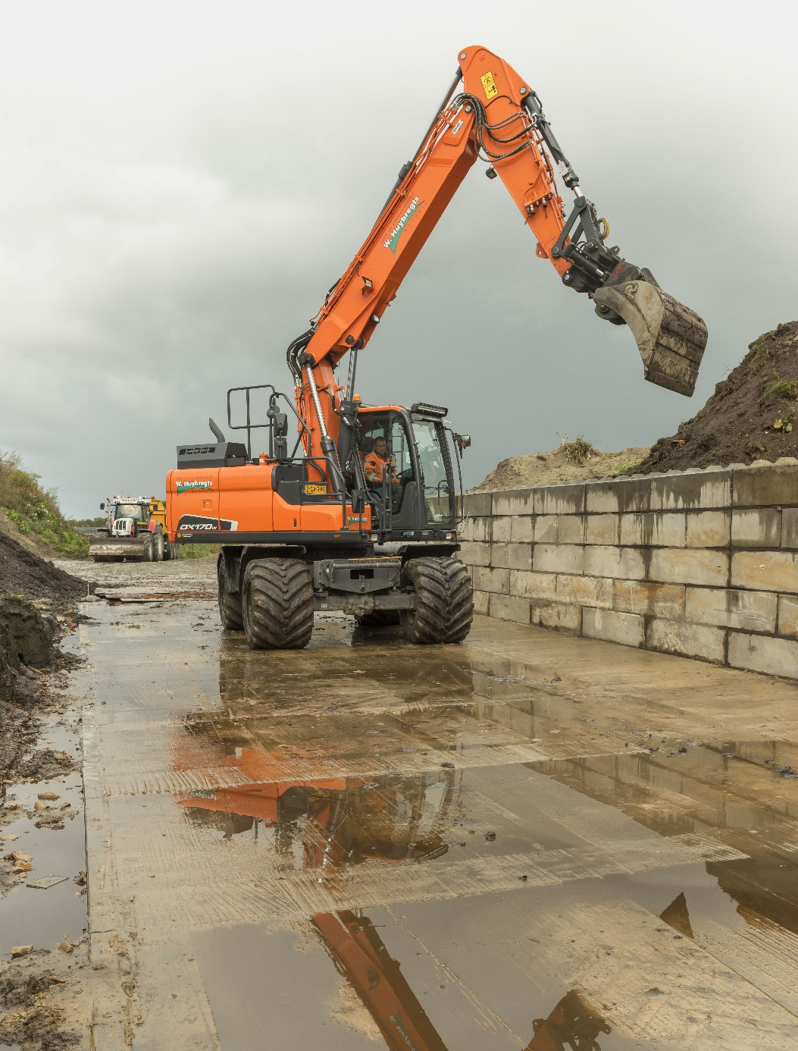
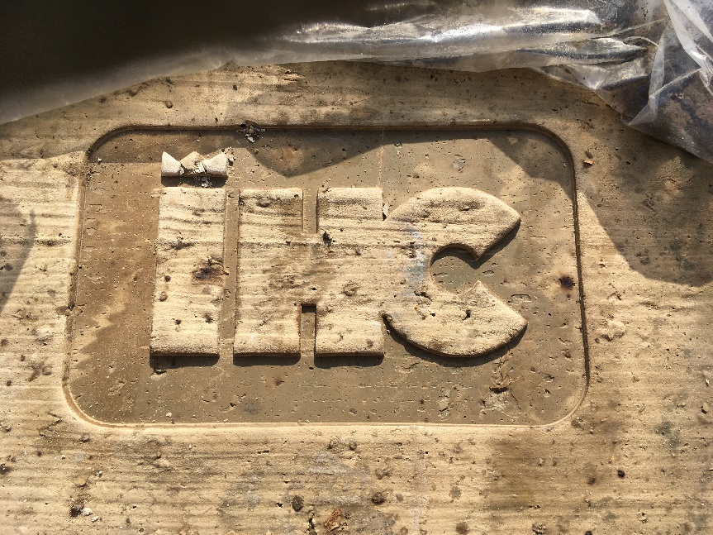
IHC Medusa B.V. > Technology and expertise
      IHC Medusa test field 2017
Case:
Test field prototype of 1 ton/h
Excavate surface 120 mm
Reuse excavated material
No pretreatment surface underground
Result:
38 ton processed material
Platform 21 × 6 m
30 MPa after 7 days
Average temperature 17°C
Excavator test wheel pressure 4 x 4.5 ton
Notes:
http://www.aso-cement.jp/en/products/product_ordinary.html

Slide 7
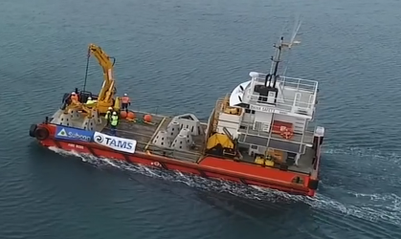
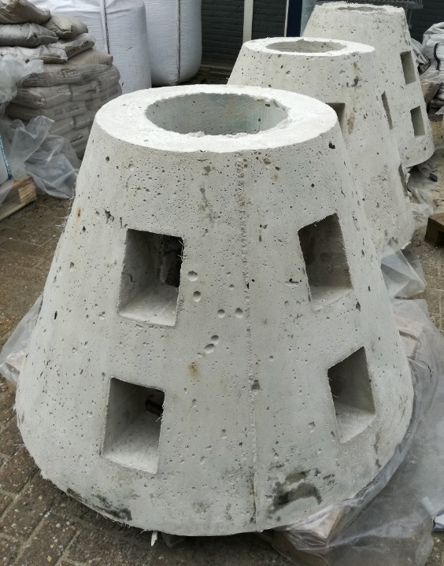
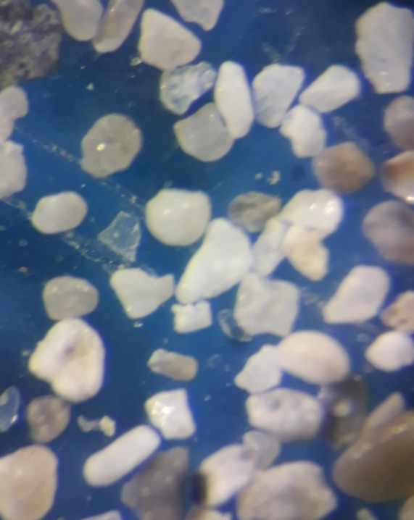
Application > ReeF BLocks
      FOrmulating a mix
No gravel available
Local matter geologically novel
Containing granular particles
Solution
Adding fines (<100 μm) improved rheology and strength

Slide 8
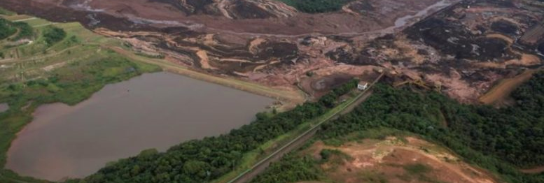
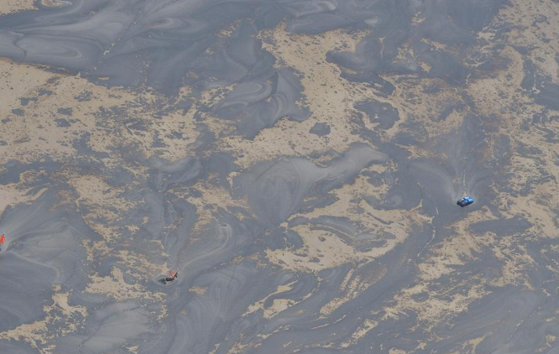
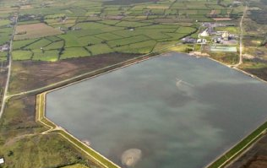
Application > tailing PONDS
Infrastructure
Roads
surface areas
Dykes
Soil stabilization
Combination with dredging expertise
Notes:
Our expertise in dredging may aid in the provision of a holistic solution
dredging (currently doing) + soil stabilisation + dykes

Slide 9
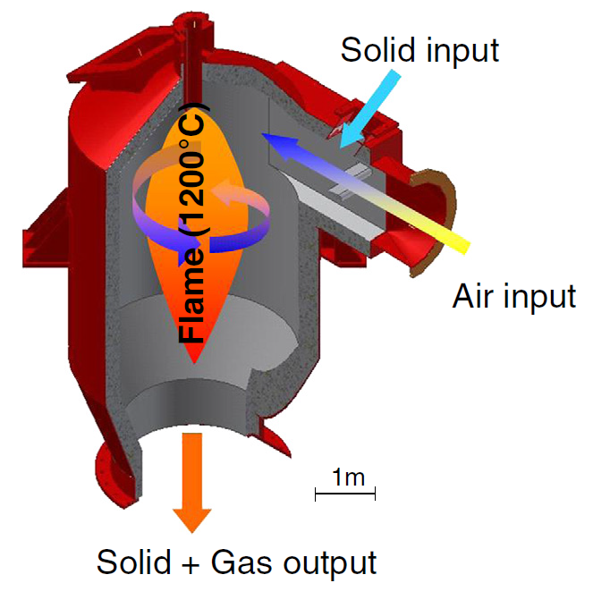
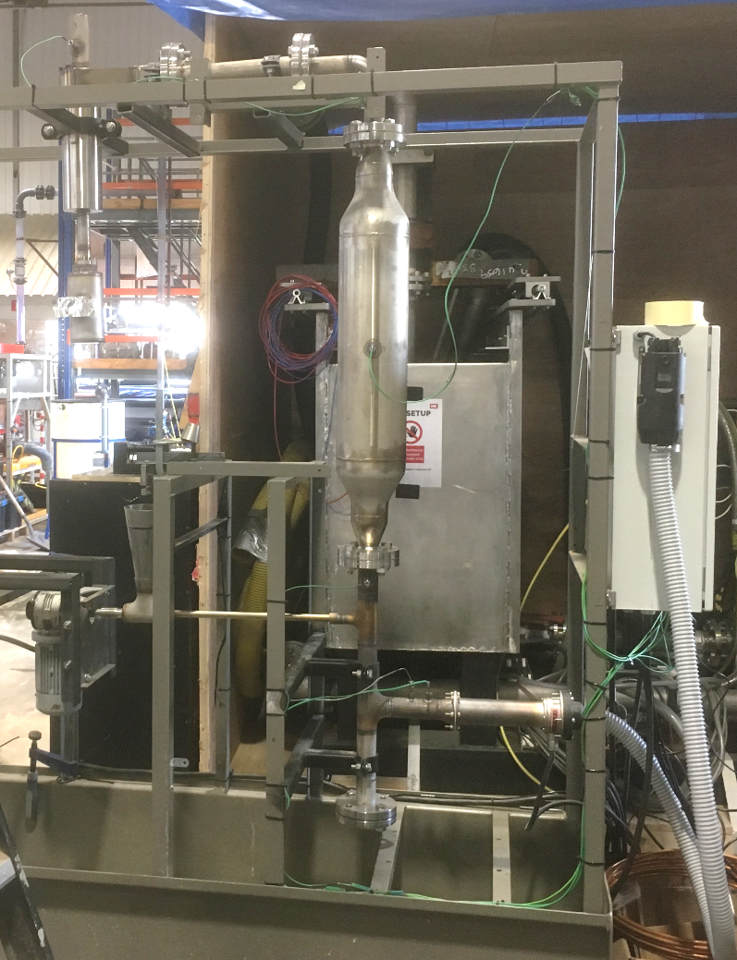
EXperimental > Clay and waste activation by Flash calcination
      Flash CAlcination
Properties
Fast heating rate
Higher temperatures*
Shorter residence times*
Small particle size of feed
Rapid cooling rate
*compared to classical calcination
Schematic flash calcination (left), lab calciner (right)

Slide 10
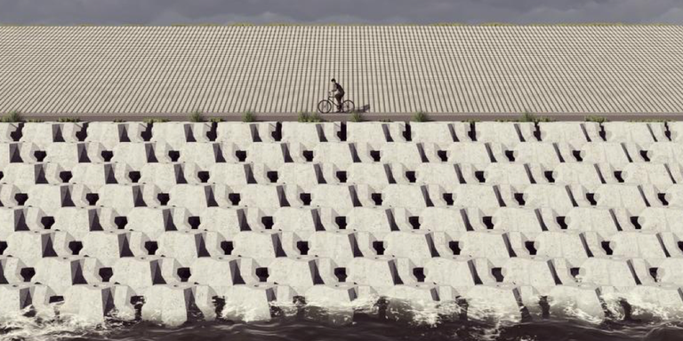
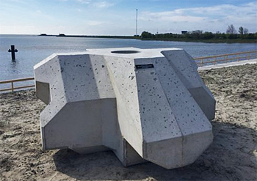
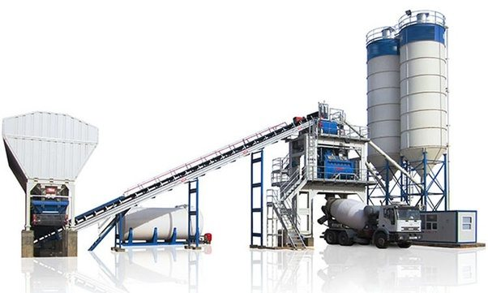
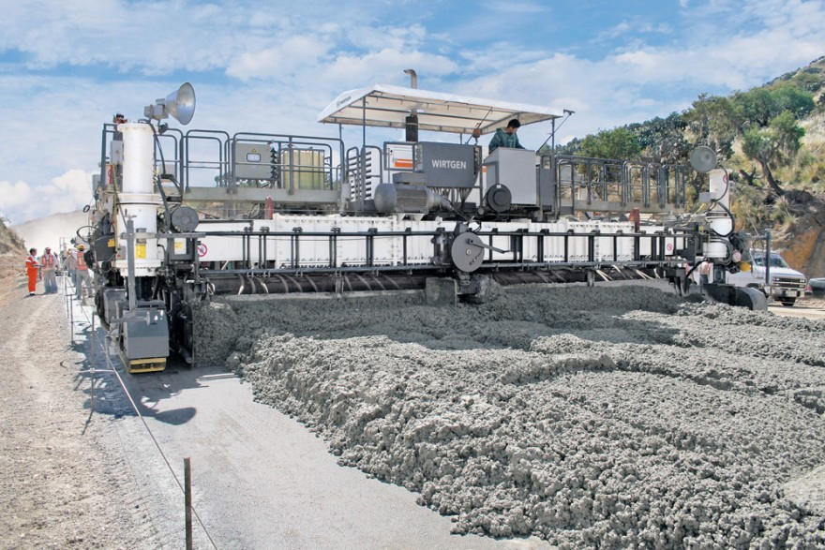
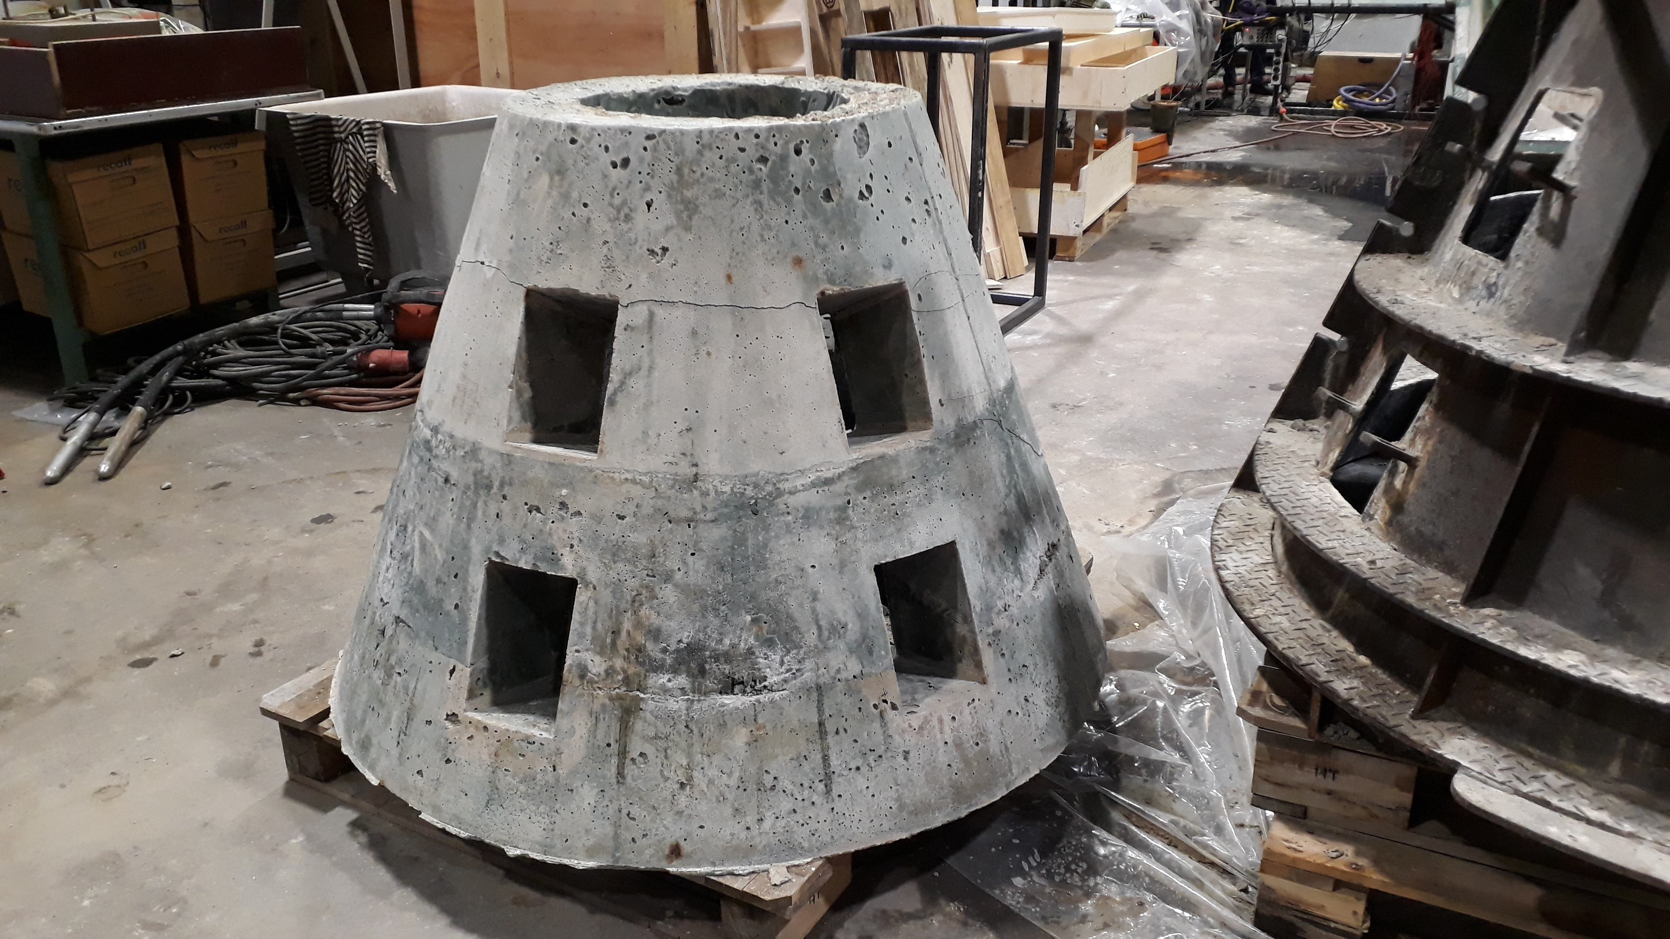
OpportUnIties for collaboration
Many opportunities for infrastructure and soil stabilisation with our technology
We are looking for companies that want to explore application of our solutions in their projects
Are you interested? Let me know!
Notes:
Say geopolymer evidence

Slide 11
Thank you for your attention

